Slide 1

NodeJS, npm & JSON

Slide 2
NodeJS/NPM module design
Cheat Sheet for NPM
Overview of NodeJS
Node JS Modules
Local Modules
What is npm
uninstalling the packages
updating the
packages
installing the packages
Components of
npm
S/W Requirements
Installer : NodeJS
Browser: Google Chrome

Slide 3
Overview of NodeJS
2

Slide 4
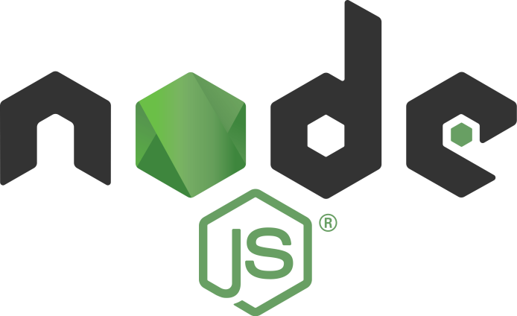
Node JS
Node.js is an open-source, cross-platform JavaScript run-time environment that executes JavaScript code outside of a browser.
Node.js is used for development of server-side web applications.
Node.js lets developers use JavaScript to write command line tools and for server-side scripting—running scripts server-side to
produce dynamic web page content before the page is sent to the user's web browser.
Initial version was released in May 2009. The current version is
21.7.3 released April 2024.
The official website is http://nodejs.org

Slide 5
NodeJS Modules

Slide 6
NodeJS Modules
Module in Node.js is a simple or complex functionality organized in single or multiple JavaScript files which can be reused throughout the Node.js application.
Node.js includes three types of modules:
Core Modules (http, url, fs etc.)
Local Modules (User defined module)
Third Party Modules (React, Bootstrap, jquery etc.)

Slide 7
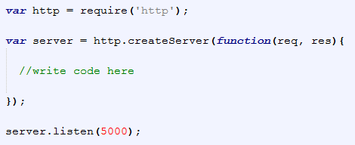
Core Modules
NodeJS comes with core modules. Below is the list of in-built modules.
S No | Module Name | Description
1 | http | http module includes classes, methods and events to create Node.js http server
2 | url | url module includes methods for URL resolution and parsing
3 | querystring | querystring module includes methods to deal with querystring
4 | path | path module includes methods to deal with file paths
5 | fs | fs module includes classes, methods and events to work with file I/O
6 | util | util module includes utility functions for the programmers
•
Load an
d use core modul
es

Slide 8
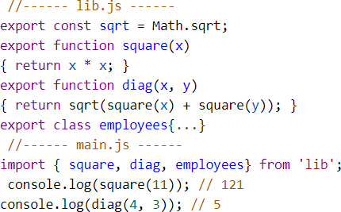
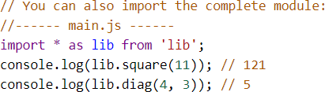
Local Modules
Local modules are modules created locally in your Node.js application. These modules include different functionalities of your application in separate files and folders.
The export statement is used when creating JavaScript modules to export classes, functions, objects or primitive values from the module so they can be used by other programs with the import statement.
A module can import things from other modules using module specifiers like:
Relative paths ('../model/user‘)
Absolute paths ('/lib/js/helpers')
Modules are singletons. Even if a module is imported multiple times, only a single “instance” of it exists.

Slide 9
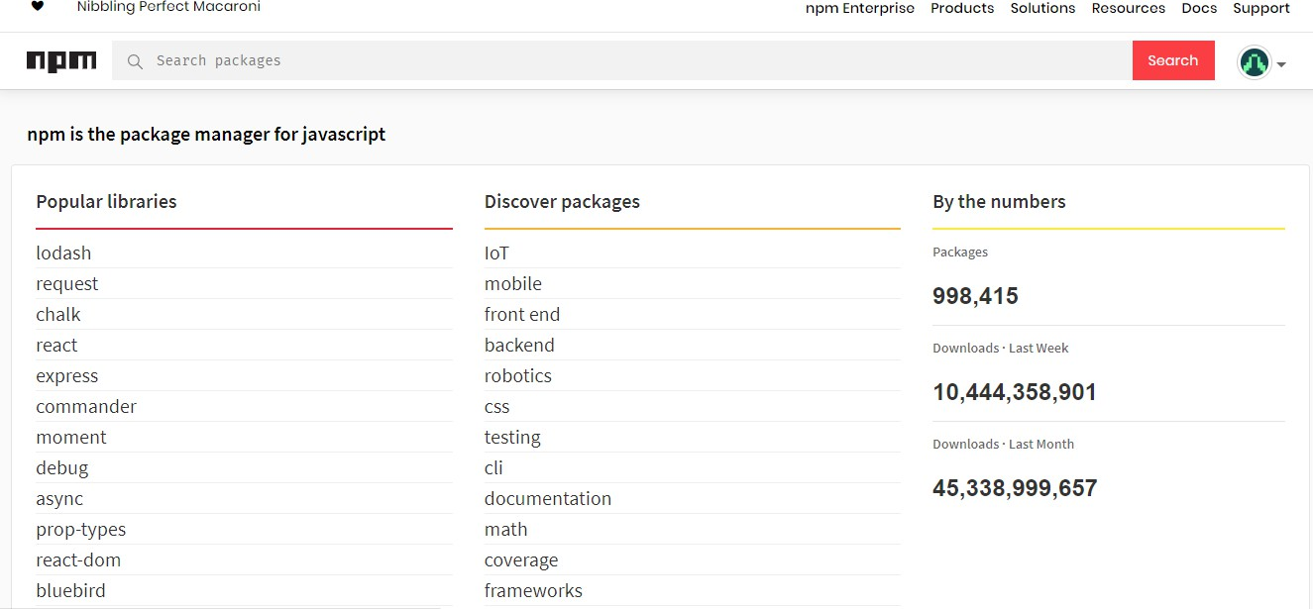
Third Party Modules
Third party modules are nothing but available in npm database like React, Bootstrap, jquery , webpack etc. and can be installed or uninstalled using npm.

Slide 10
npm
9

Slide 11
Presenting the use case
10

Slide 12
Use case on npm
Create the package.json file using npm
Install bootstrap as local and
typescript as global package
Uninstall bootstrap using npm and check the behavior of page
Create a page which uses bootstrap classes and refer bootstrap.css file from the installed package

Slide 13

What is npm
npm (originally short for Node Package Manager) is a package manager for the JavaScript programming language.
It allows users to consume and distribute JavaScript modules that are available on the registry.
The registry is an online database of public and paid-for private
packages.
The registry is accessed via the npm command tool and the
available packages can be browsed and searched via the npm website.
First version was released in January 2010. The current version is
10.5.2 released in April 2024.
Official website is www.npmjs.com

Slide 14
Components of npm
npm consists of three distinct components:
the website : the primary way developers discover packages, set up profiles, and manage other aspects of their npm experience.
the registry : a large database of information about packages
the Command Line Interface (CLI): runs from a terminal. This is how most developers interact with npm.
npm website and registry

Slide 15
npm Installation
npm is automatically installed with node.js installation. However, npm gets updated more frequently than Node.js, so be sure that you have the latest version.
S No. | Command | Description
1 | npm -v | To test current version
2 | npm install npm@latest -g | If the current version does not match the latest version. It will download the latest version

Slide 16
Install, Uninstall and Update of packages

Slide 17
Installing the packages
Packages may contain multiple modules or a single module. Packages are used to group together files offering relevant tools.
There are two ways to install npm packages: locally or globally.
If you want to depend on the package from your own module, then install it locally. This is the choice you would use if you are using require statements, for example. jQuery, Bootstrap etc.
npm install <packagename>
This will download module at the location from where you are running the command.

Slide 18
Installing the packages cont…
Global Installation: If you want to use a package as a command line tool, then install it globally. This way, it works no matter which directory is current. For example grunt, typescript etc.
npm install <packagename> -g This will download module at below location:
C:\Users\<username>\AppData\Roaming\npm\node_modules

Slide 19
Updating the packages
It's a good practice to periodically update the packages your application depends on. Then, if the original developers have improved their code, your code will be improved as well.
npm outdated. There should be few
outdated packages.
npm update in the same directory as
the package.json file of the application that you want to update.
npm outdated. There should not be any
results.

Slide 20
Uninstall the packages
To remove a package from your node_modules directory, use: npm uninstall <package>

Slide 21

JSON

Slide 22

JSON
JSON (JavaScript Object Notation) is a lightweight data-interchange format. It is easy for humans to read and write. It is easy for machines to parse and generate that is the reason it works as the replacement of XML
JSON is a language-independent data format. It was derived from JavaScript, but as of 2017 many programming languages include code to generate
and parse JSON-format data.
The JSON syntax is a subset of the JavaScript syntax.
The JSON format is almost identical to JavaScript objects.
The file type for JSON files is ".json"
In JSON, keys must be strings, written with double quotes.
Syntax:
JSON Object:
{"name":"John", "age":31, "city":"New York"} JSON array of objects:
{“arr”: [{"name":"John","age":30},{"name":"Jack","age":25}] }

Slide 23
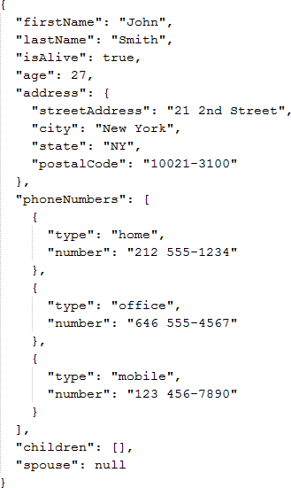
JSON value data types
In JSON, values must be one of the following data types:
a string
a number
an object (JSON object)
an array
a boolean
null
JSON values cannot be one of the following data types:
a function
a date
undefined
sample.json

Slide 24
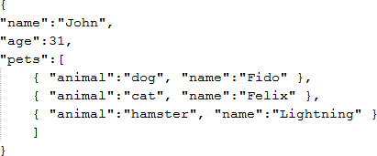
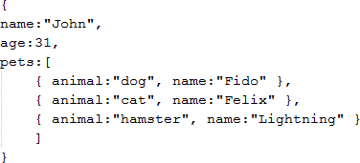
JSON Methods
A common use of JSON is to exchange data to/from a web server.
When receiving data from a web server, the data is always a string.
Parse the data with JSON.parse() and the data becomes a JavaScript object.
When sending data to a web server, the data has to be a string.
Convert a JavaScript object into a string with JSON.stringify() method.
JSON.parse(str)
JSON.stringify(obj)
JSON data (str)
Java Script Object (obj)

Slide 25
Let us work on use case on JSON

Slide 26
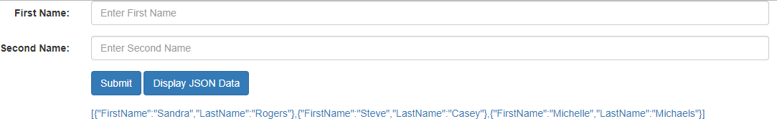
Presenting the Use case on JSON
Design the below page using bootstrap. Once the user clicks on submit button the entries get saved into JSON array and on click of Display JSON data , it should display the JSON array down.

Slide 27
Thank You

